Slide 1
British Airways Data Science Virtual Experience
Task 2
Submission by:
Anu Mishra
GitHub: anumishra10

Slide 2
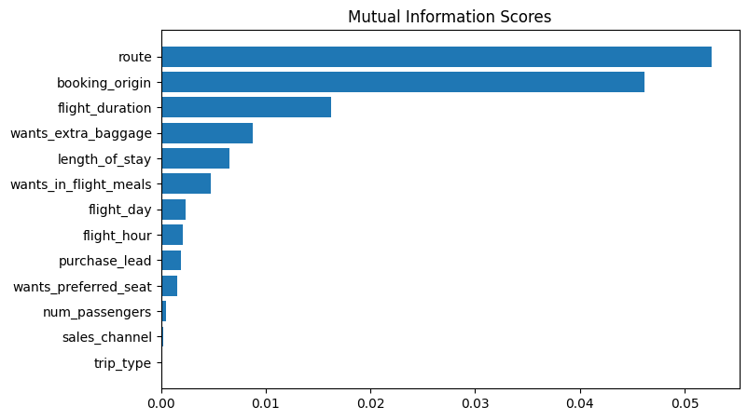
Factors that influence flight bookings
The bar plot showing words that influence in decreasing order:
ACCURACY: 85.09
AUC score: 0.55777

